Slide 1
Suffolk Netball Skills
Intercepting
Driving onto the ball

Slide 2
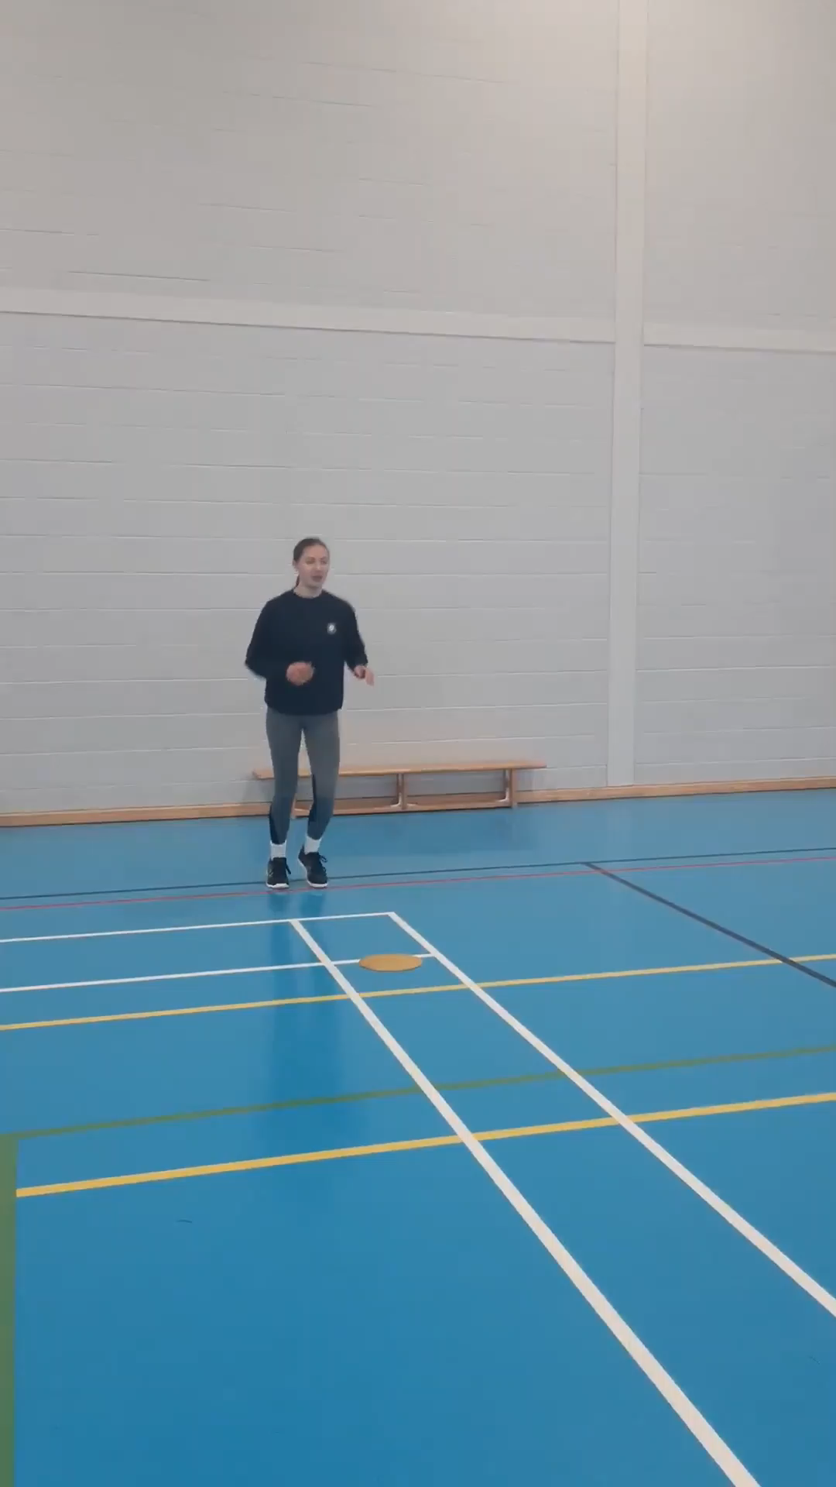
Intercepting with 2 hands
Start in ready position behind player. (spot)
Step out onto outside foot and drive
in front. (Avoid contact)

Slide 3
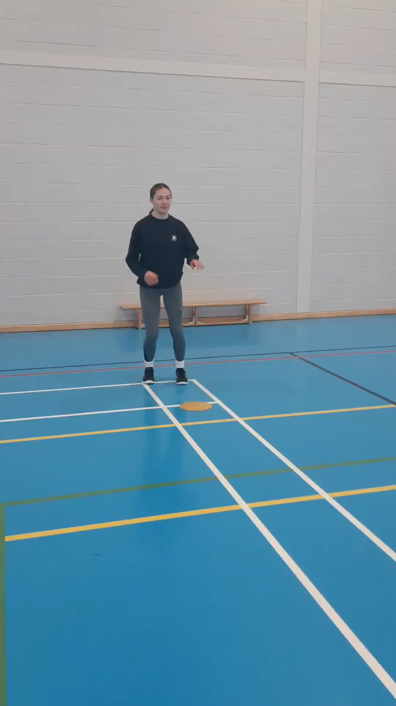
Run feet onto the ball (no Lunging)
Aim to take ball as far away from
player as possible.

Slide 4
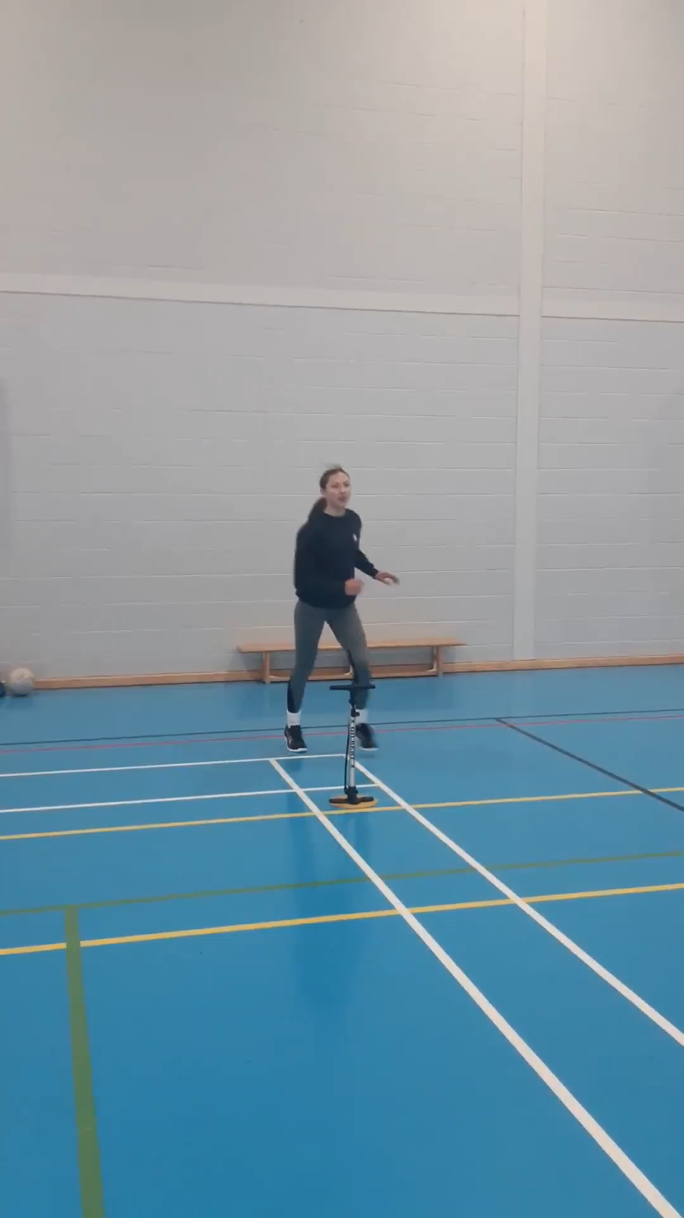
Intercept using Reverse hand
For when you cant use 2 hands
To avoid contact

Slide 5
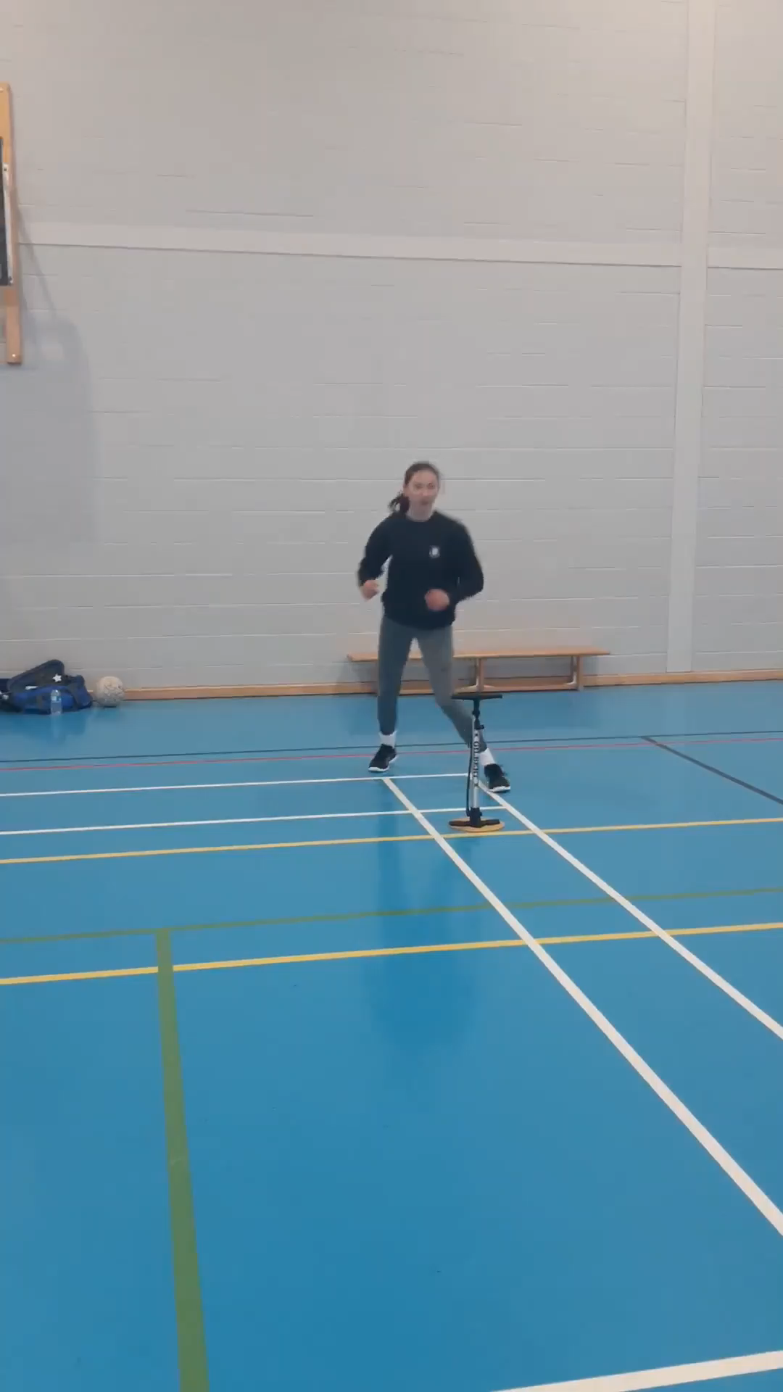
Time your move to come round the player
Gain control of the ball as quickly as possible.

Slide 6
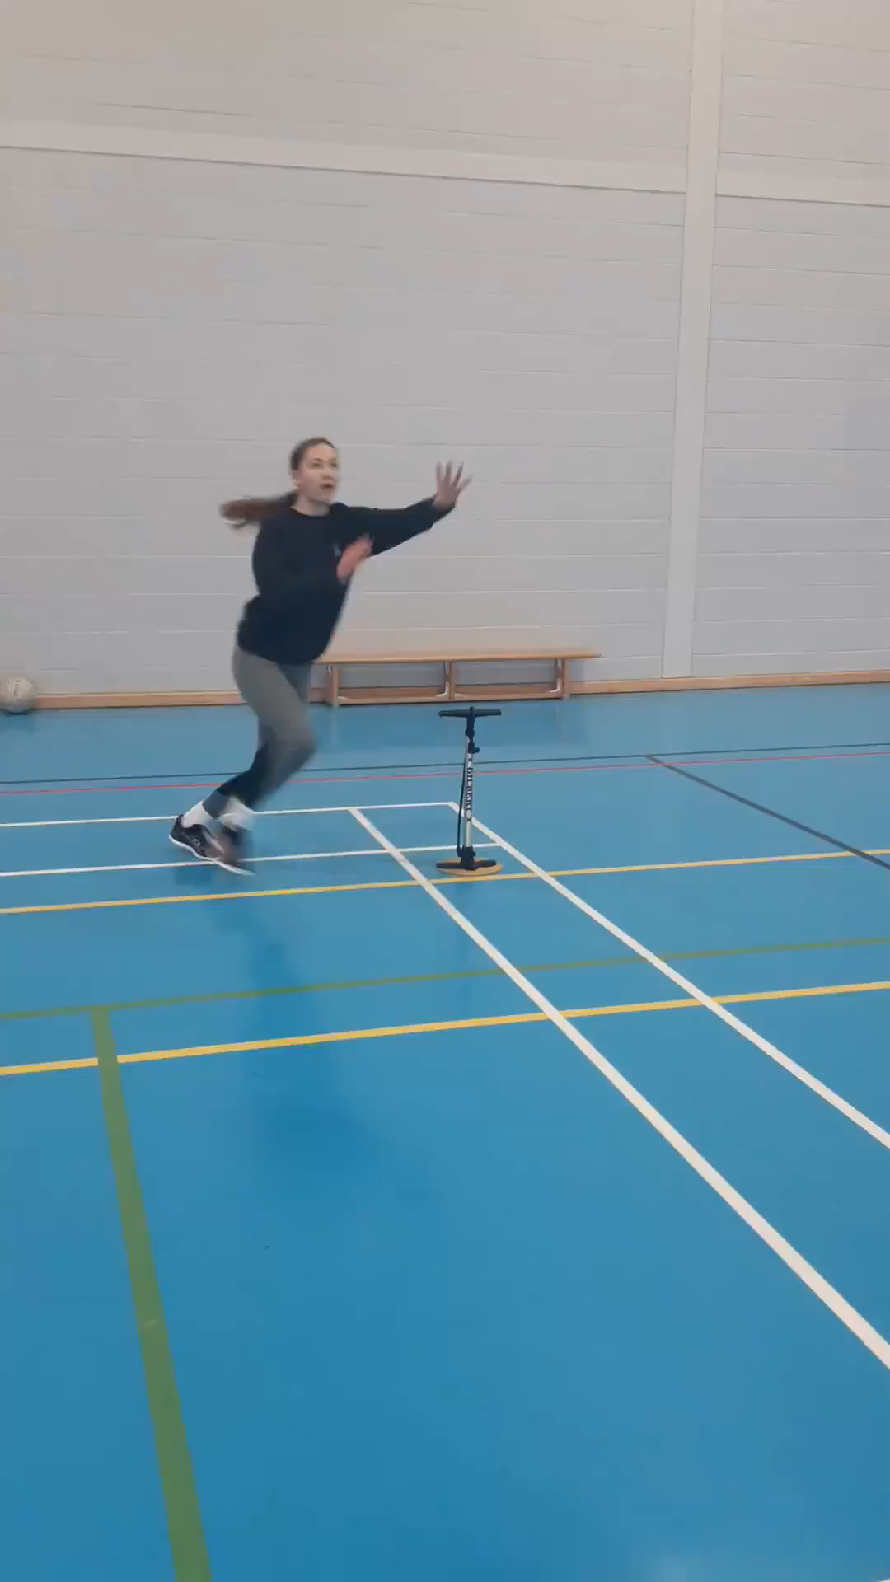
Now mix it up!
Vary angle of entry to intercept
Work from both sides

Slide 7
Each time you train, aim for 5 times each side.
Have a great week!

