Slide 1
Suffolk Netball ball work
Centre Pass
2nd phase

Slide 2
Q. Where do you want the ball to go after the first catch?
A. Aim for the ball to go forward into the attacking 1/3.
Q. What method could you use to get free?
A. May depend on defenders position.

Slide 3
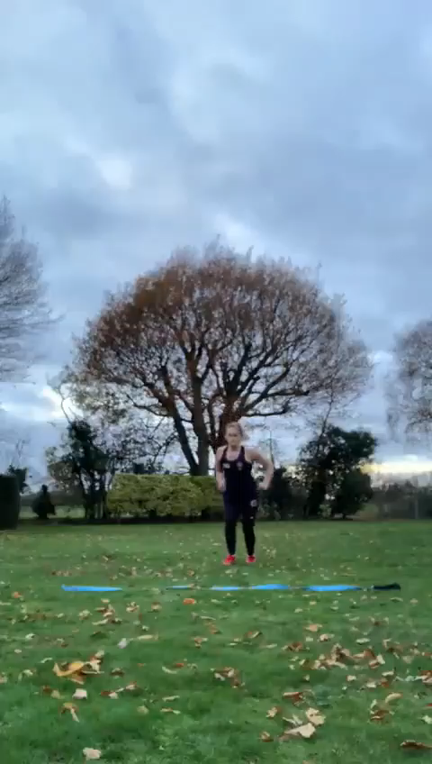
Without defender
Drive out over the line as if you are offering
for the 1st pass.
Imagine your defender is not with you.
Use a change of direction to re offer for the
2nd pass.
Turn hips and shoulders fully to face
the direction you are going in and run on an
angle.
Don’t forget your turn to face goal when you
receive the ball

Slide 4
Q. Why could you use a Change of direction
when your defender is not with you?
Quickest way to turn to post.
You can still scan most of the court.

Slide 5
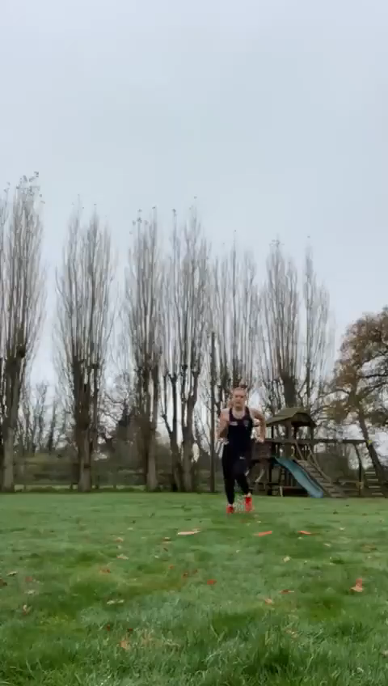
With a defender
As before, drive past the line.
This time you could use a reverse
pivot to lose your defender and get free.
Defender is ball side- (inside)

Slide 6
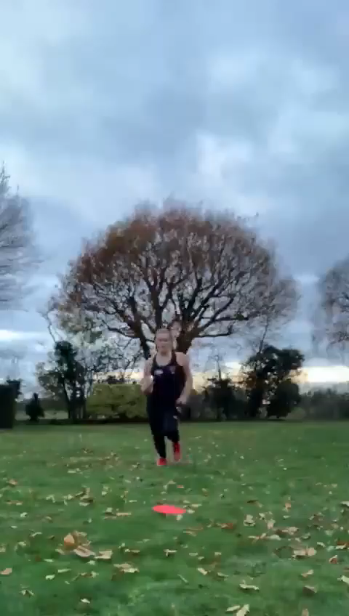
Reverse Pivot
You can practice the RP in isolation.
Pivot making a quick turn with back
to defender.
Head round quickly to sight feeder and
sprint out to receive the ball.

Slide 7
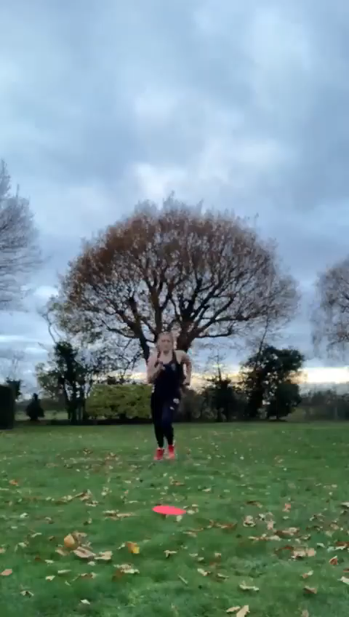
Remember to practice both sides.

Slide 8
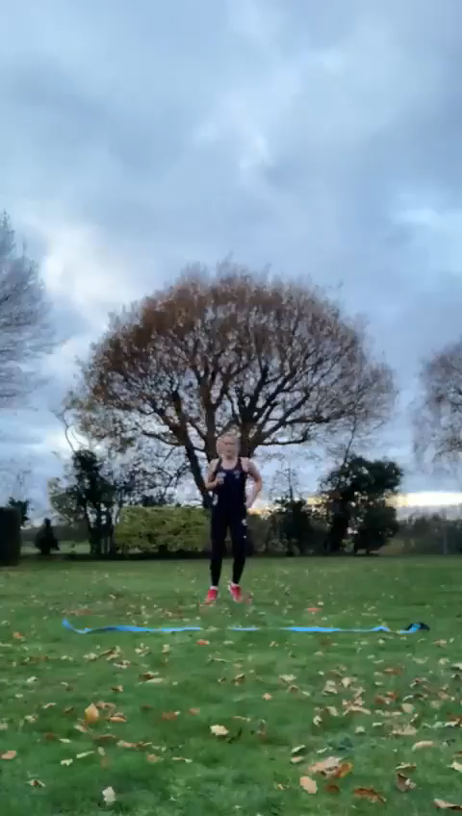
As a progression, what can you do if
the defender lets you go on the first pass
but meets you in the attacking third?

Slide 9
Aim to work for 5 each side on both options when you practice.
Have a great week!

