Slide 1
Suffolk Netball Ball Work
Turning to face goal
Outward turn

Slide 2
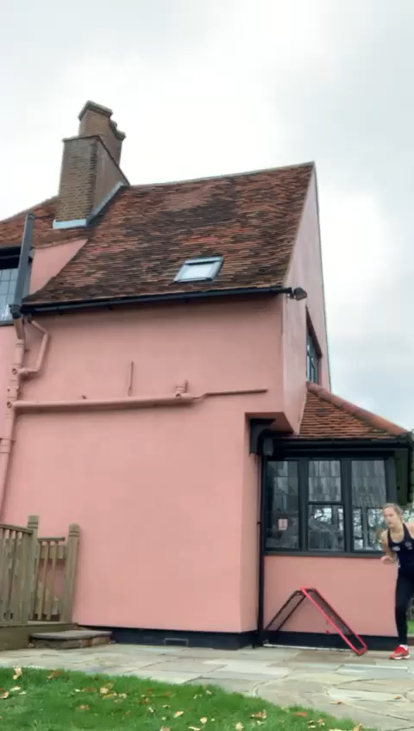
Why do we need to turn?

Slide 3
So you can face goal and scan to see the attack and defence
Enables quicker release of the ball

Slide 4
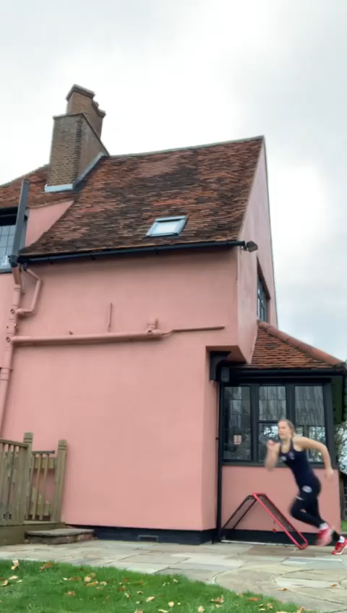
Turn head, shoulder and hips quickly and fully.

Slide 5
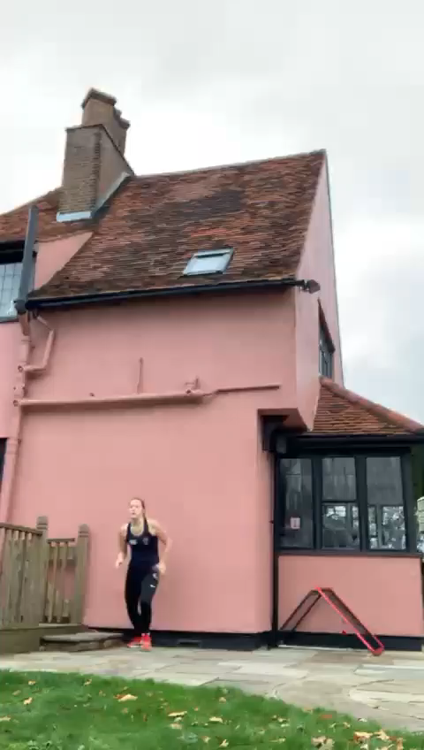
Make sure you are working on turning both sides and release on your dominant and non dominant side. (Shoulder pass)

Slide 6
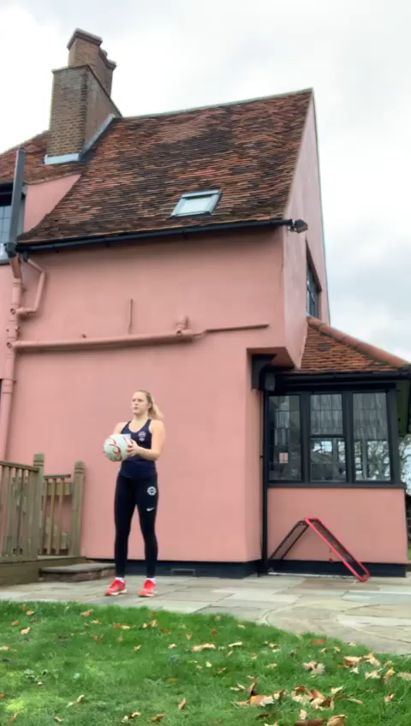
What can you do without
a partner?

Slide 7
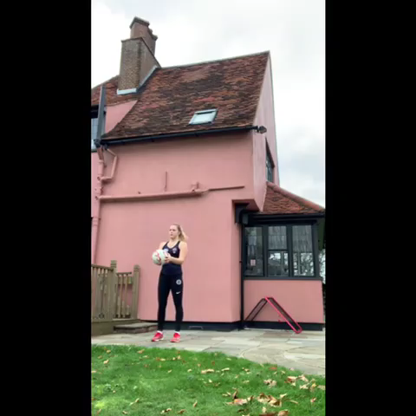
Start to turn on take off but keep
your eye on the ball.

Slide 8
Aim for 10 turns each side when you practice.
Have a great week!

